Slide 1
UTube
Harish Kumar Vaithyan Nandhagopu Aishwarya Venkatesan Barathi Sridhar
Karthik Prakash

Slide 2

Purpose
It provides a wide range of videos for entertainment and
learning purpose.
Can be used to connect with other people by subscribing
to channels , leaving comments and engaging with
community.
It provides businesses and individuals with a platform to
promote their products or services.

Slide 3

TECH STACK

Slide 4






Workflow
The User has to create account in the application by registering with an email address.
Email verification would be sent for confirmation.
After Verification account would be created for user.
User can upload videos and delete them.
Users can view the video uploaded by other users.
Users can like and comment on the videos.

Slide 5
Features
Register and Login Functionality.
Email verification for Sign Up using JWT.
Like and Comment Feature.
Upload and Delete videos.
User friendly and easy application.
Video description provided.
Custom made video player.
User can download and view in various speeds.

Slide 6
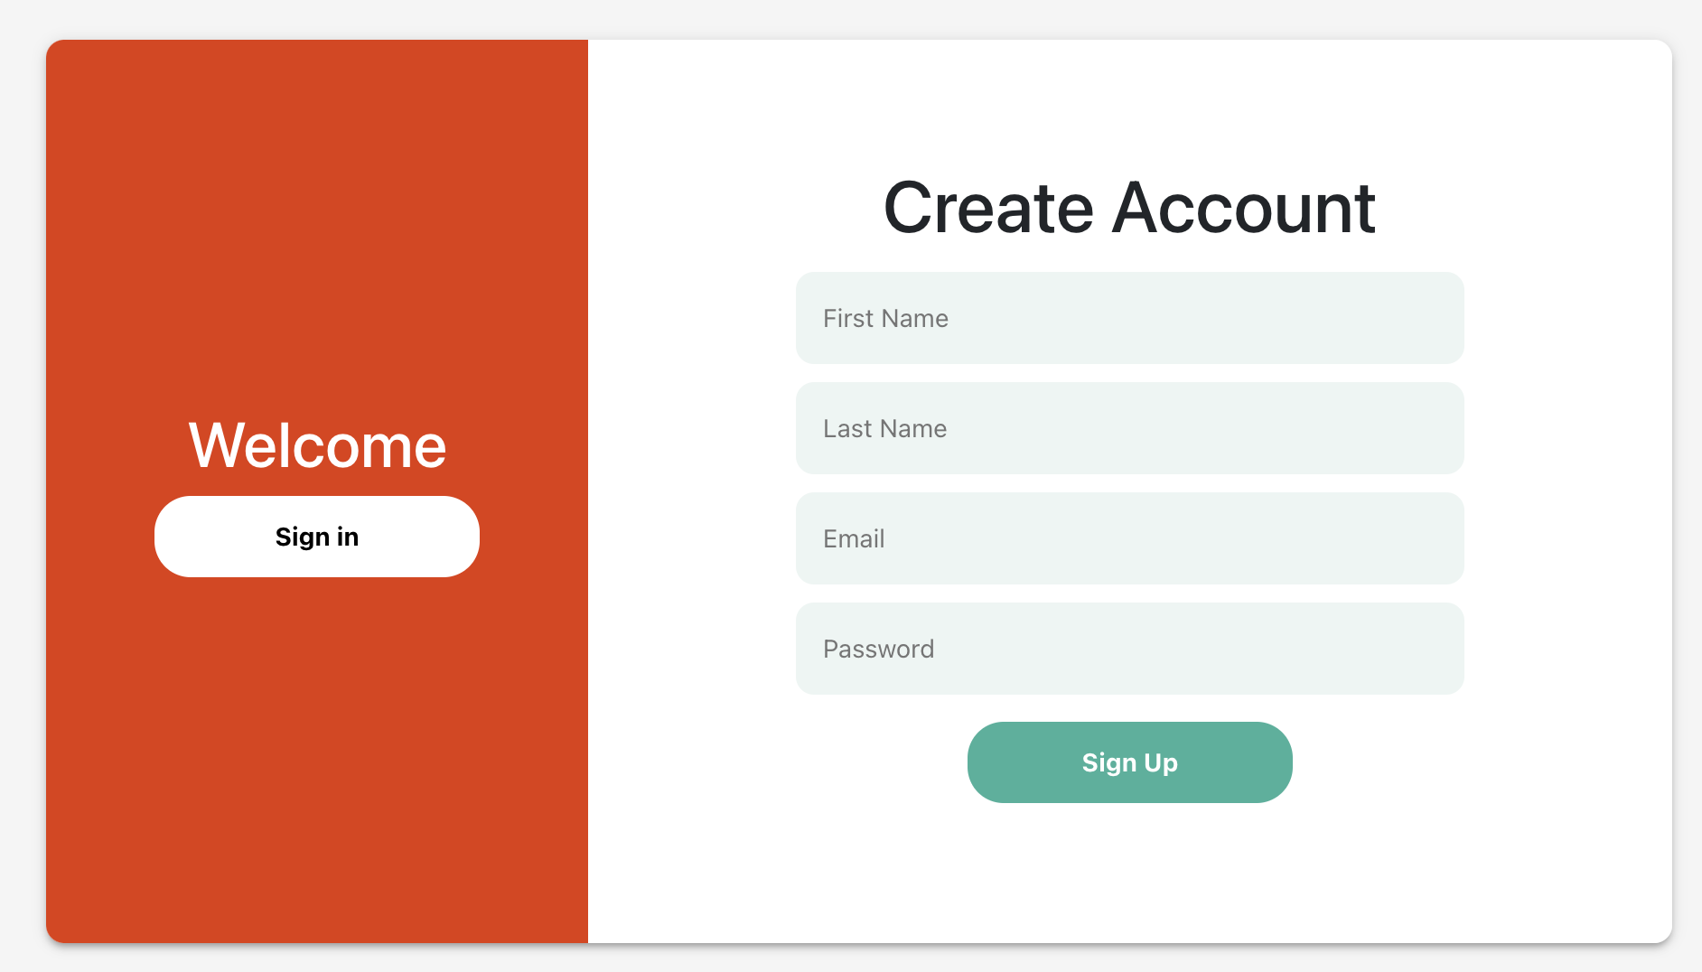
Register Page

Slide 7
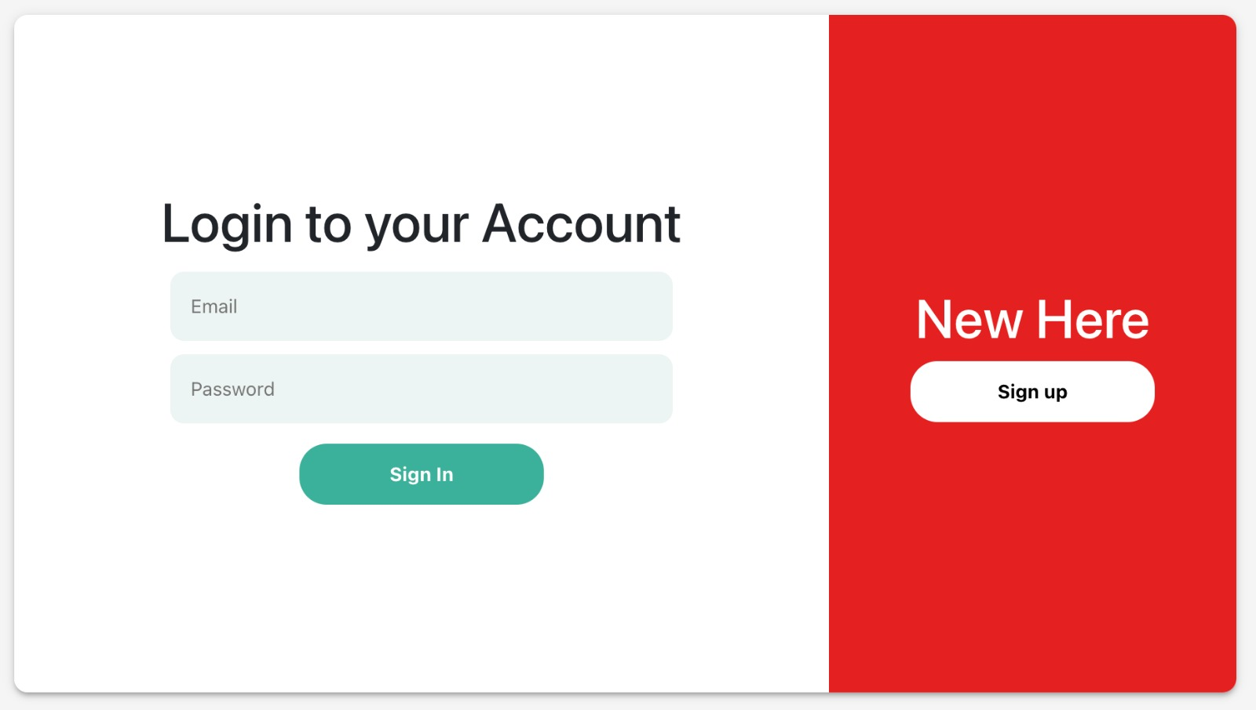
Login Page

Slide 8
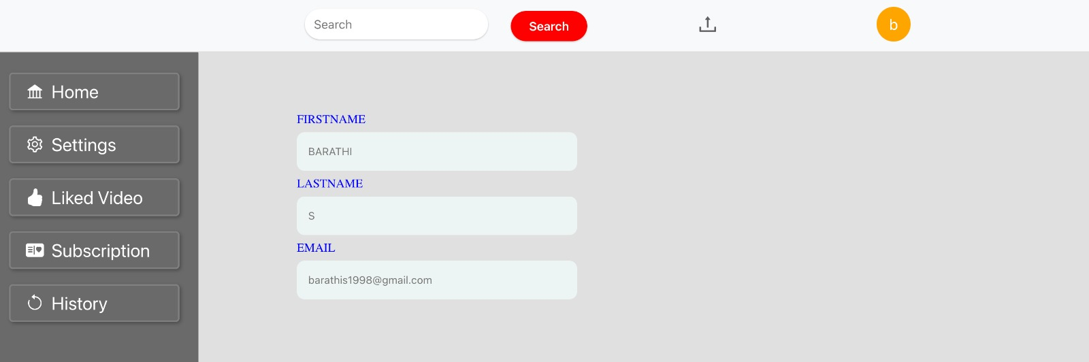
User Profile

Slide 9
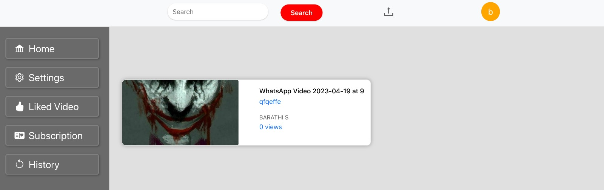
Home Page

Slide 10
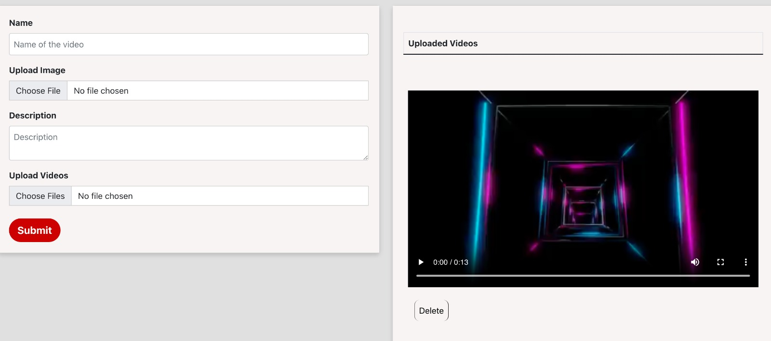
Video Upload Page

Slide 11
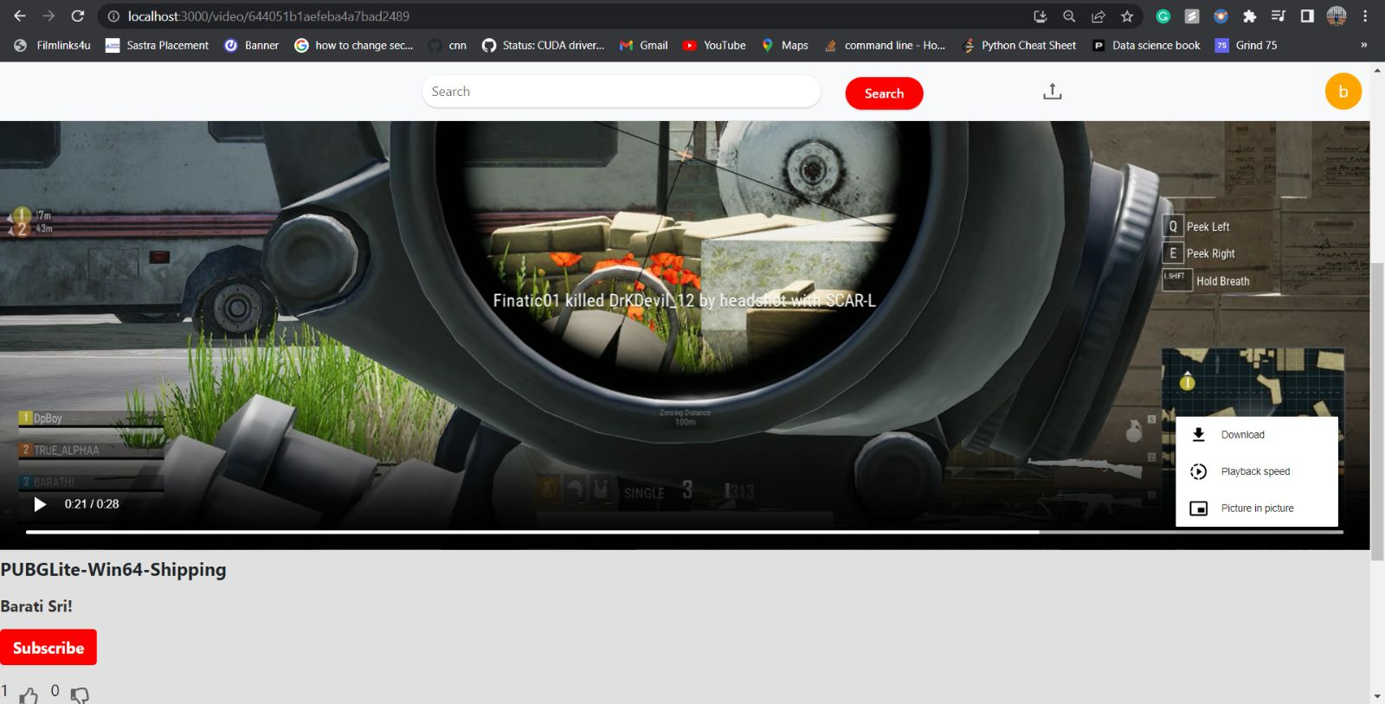
Video Player

Slide 12
Future Enhancements
Cloud Deployement.
Integrating payment gateway for utube premium.
Security feature for videos.
Providing Online Streaming.

Slide 13
References
https://github.com/techreagan/youtube-clone-nodejs-api

Slide 14
Thank You

